Slide 1


SMART INDIA HACKATHON 2025
BitREAPER – Secure & Embeddable Solution For Data Sanitization
Problem Statement ID → SIH25070
Problem Statement Title →
Theme → Miscellaneous
PS Category → Software
Team ID-
Team Name - SAHAS
Secure Data Wiping for Trustworthy IT Asset Recycling

Slide 2
BitREAPER – Secure & Embeddable Solution For Data Sanitization
SAHAS
Proposed Solution:
Bootable USB tool for secure and irreversible disk erasure.
Runs independent of host OS which gives full control of wipe process.
Compliant with NIST SP 800-88 media sanitization guidelines.
Uses trusted open-source utilities (nwipe, hdparm, nvme-cli).
Verification utility ensures wipe success.
Generates digitally signed, tamper-proof wipe certificate.
Simple UI helps non-technical users operate the program easily.
Low-cost and portable, powered by FOSS tools.

Slide 3
TECHNOLOGIES USED
SAHAS
To actually perform wipe operations on:
HDDs: nwipe (FOSS utility)
SATA SSD: hdparm (inbuilt Linux utility)
NVMe SSD: nvme-cli (inbuilt Linux utility)
Debian for the base OS with xserver
Python with PyQT5 for UI
To verify the disk wiped, we use dd ( FOSS utility)

Slide 4
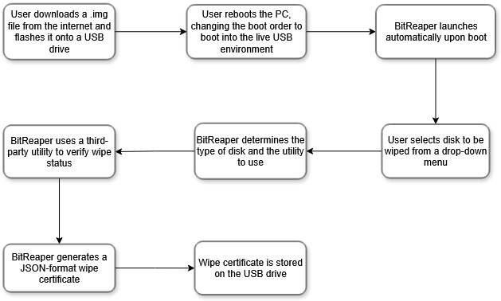
FLOWCHART
SAHAS

Slide 5
FEASIBILITY AND VIABILITY
SAHAS
Built on trusted, widely used open-source utilities for secure and reliable data sanitization.
Low operational cost since it exclusively leverages free and open-source software (FOSS)
Intuitive user interface enables even non-technical users to operate the tool with ease.
The installation process requires the user to flash a .img file to a USB drive and change the boot order in the system's BIOS to boot into the live USB
No built-in method to automatically transfer or back up wipe certificates from the USB to another location
Create an installer which smoothly integrates the USB flashing process
Create an interface to allow the program to upload generated wipe certificates to the web if it is connected to the internet
Create a web interface for the user to easily interact with the previous logs / certificates generated by the software
Lack of verification to confirm tool usage on the owner’s system may allow malicious actors to misuse it for unauthorized data destruction
STRENGTH
WEAKNESSES
OPPOURTUNITITES
THREATS

Slide 6
IMPACT AND BENEFITS
SAHAS
Ensures trustworthy IT asset recycling by preventing data leaks.
Increases user confidence in disposing/recycling old devices.
Reduces the risk of cybercrime through data recovery.
Provides standardized, certified wiping aligned with NIST guidelines.
Promotes adoption of secure e-waste management practices.
Social: Protects personal and organizational privacy, builds digital trust.
Economic: Reduces data breach costs, enables safe resale/refurbishment of IT assets.
Environmental: Encourages safe recycling of devices, lowering e-waste accumulation.
Accessibility: Easy-to-use UI allows even non-technical users to securely wipe data.
Cost-effective: Built on FOSS tools, minimizing operational costs.
Scalable: Potential for integration with web platforms for logs and certification management.
IMPACTS
BENEFITS

Slide 7
RESEARCH AND REFERENCES
SAHAS
Data erasure on HDD https://www.stellarinfo.com/article/7-algorithms-to-wipe-files-folders-permanently.php
Gutmann method https://www.cs.auckland.ac.nz/~pgut001/pubs/secure_del.html
nwipe https://github.com/martijnvanbrummelen/nwipe
hdparm https://linux.die.net/man/8/hdparm
nvme-cli https://github.com/linux-nvme/nvme-cli
TestDisk https://www.cgsecurity.org/testdisk_doc/

